Slide 1


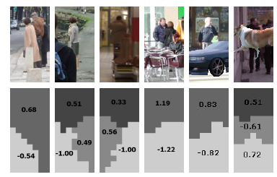
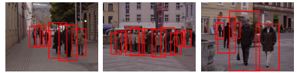
An HOG-LBP Human Detector with Partial Occlusion Handling
Xiaoyu Wang*, Tony X. Han*, and Shuicheng Yan†
* ECE Department
University of Missouri, Columbia, MO, USA
† ECE Department
National University of Singapore, Singapore

Slide 2
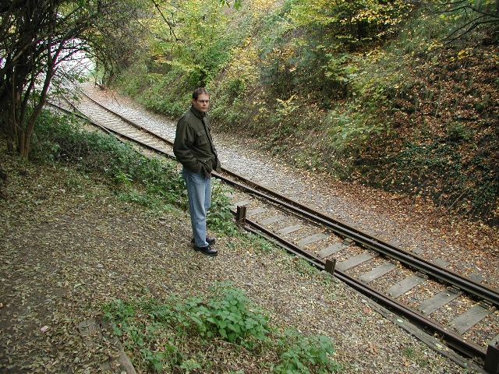

Introduction
Human detection, or more generally, object detection, has wide applications
Currently, Sliding Window Classifiers (SWC) achieves the best performance in object detection
  “Sliding window classifier predominant”
  (Everingham et al. The PASCAL Visual Object Classes Challenge workshop 2008, 2009)
  -“HOG tends to outperform other methods surveyed,”
  (Dollar et al. “Pedestrian Detection: A Benchmark”, CVPR2009)
But still, lots of things need to be improved for SWCs
  More robust features are always desirable
  Compared with part-based detector, sliding window approach handles occlusion poorly
Binary Classifier
Pos: patch with a human
Neg: patch with no human

Slide 3
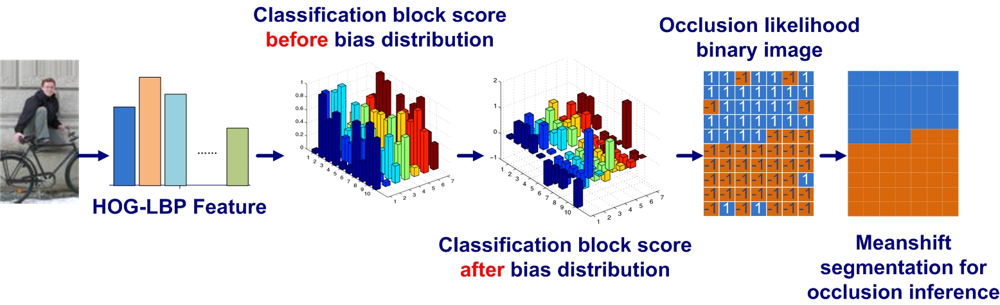
Outline
The proposed HOG-LBP feature
Partial occlusion handling
Results and performance evaluation
The speed: making it real-time!
Conclusion and real-time demo

Slide 4
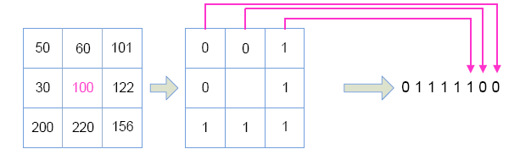
HOG and LBP feature
Traditional HOG Feature
-N. Dalal and B. Triggs. Histograms of oriented gradients for human detection. In CVPR 2005, vol. 1, pp. 886–893, 2005.
Traditional Local Binary Pattern (LBP) feature
  LBP operator is an exceptional texture descriptors
  LBP has achieved good results in face recognition
  T. Ahonen, et al. Face description with local binary patterns: Application to face recognition. IEEE PAMI, 28(12):2037–2041, 2006.

Slide 5
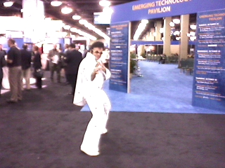
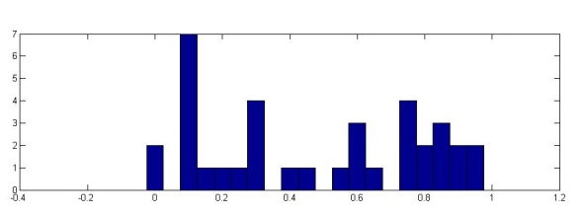
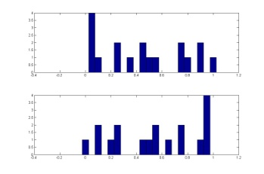

Cell-structured LBP designed especially for human detection
Holistic LBP histogram for each sliding window achieves poor results.
Inspired by the success of the HOG, LBP histograms are constructed for each cell with the size 16by16
  In contrast to HOG, no block structure is needed if we use L1 normalization.
…

Slide 6
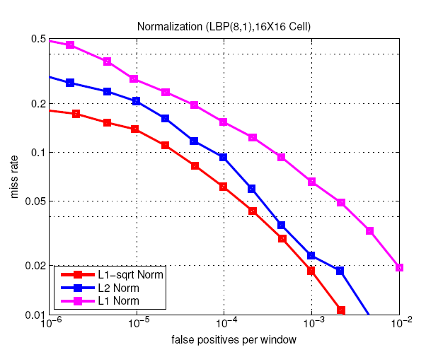
The performance of cell-structured LBP
Missing rate vs. False Positive Per scanning Window (FPPW)
Results on INRIA dataset
Feature:
Cell-structured LBP
Classifier:
Linear SVM
HOG

Slide 7
HOG-LBP feature
Why simple concatenation helps?
Disadvantage of HOG:
  Focusing on edge, ignoring flat area
  Can not deal with noisy edge region
Advantage of Cell-LBP:
  Treat all the patterns equally
  Filter out noisy patterns using the concept of “uniform patterns ”, i.e. vote all strings with more than k 0-1 transition into same bin.

Slide 8
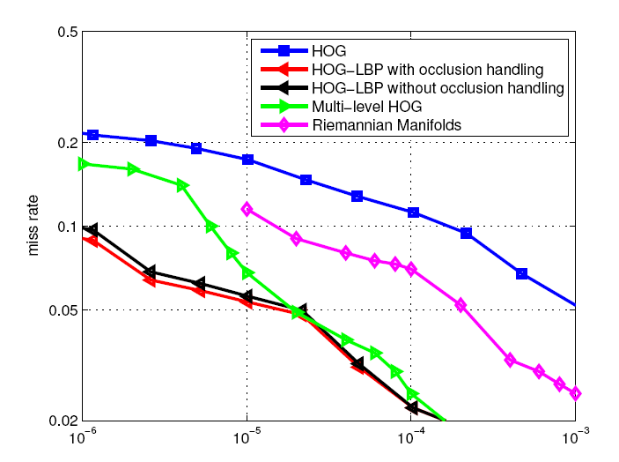
The performance of HOG-LBP feature
Missing rate vs. FPPW
[1] N. Dalal and B. Triggs, “Histograms of oriented gradients for human detection,” in CVPR, 2005.
[2] O. Tuzel, F. Porikli, and P. Meer, “Human detection via classification on Riemannian manifolds,” in CVPR 2007.
[3] S. Maji, A. Berg, and J. Malik, “Classification using intersection kernel support
vector machines is efficient,” in CVPR 2008.
[4] HOG-LBP without occlusion handling

Slide 9
HOG-LBP feature for general object detection
The proposed HOG-LBP feature works pretty well for general object detection.
We attended the Pascal 2009 grand challenge in object detection. Among 20 categories, using the HOG-LBP as feature, our team (Mizzou) got:
  Number 1 in two categories: chair, potted plant
  Number 2 in four categories: bottle, car, person, horse

Slide 10
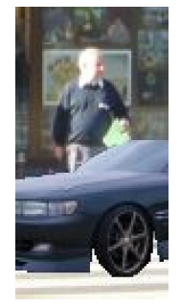
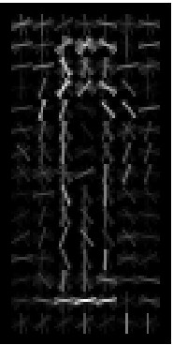
Partial occlusion handling
Two key questions
  Does the partial occlusion occur in the current scanning window?
  If partial occlusion occurs, where?
An interesting phenomenon
Negative Positive
<h_{P}, h_{U} >
<h_{N}, h_{L} >
Negative Positive

Slide 11



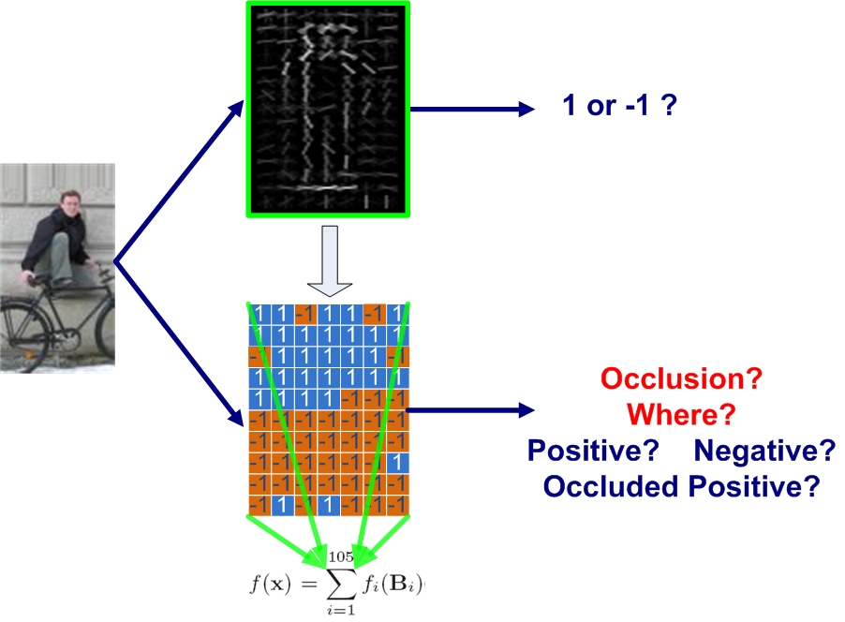
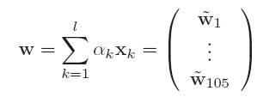
Convert holistic classifier to local-classifier ensemble
?

Slide 12





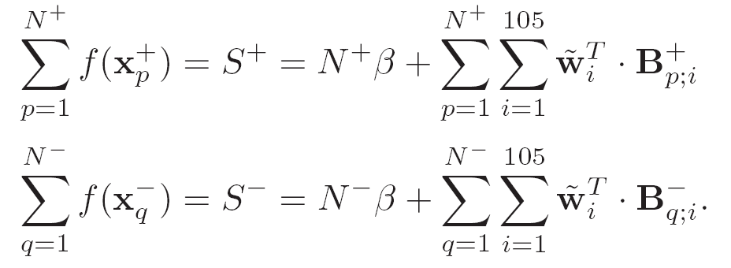


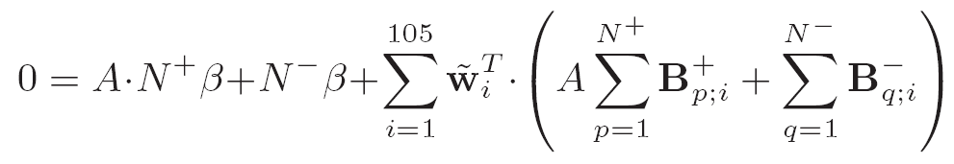
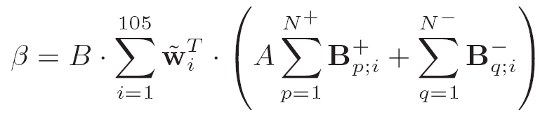

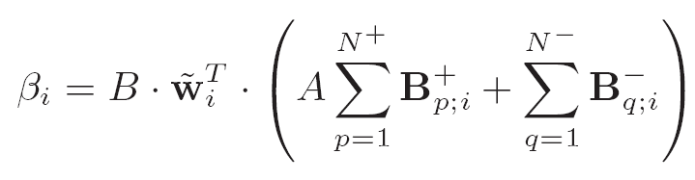

Distribute the constant bias to local classifiers
positive training samples
negative training samples
the feature of the ith blocks of
the feature of the ith blocks of
This approach of distributing the constant bias keeps the relative bias ratio across the whole training dataset.

Slide 13
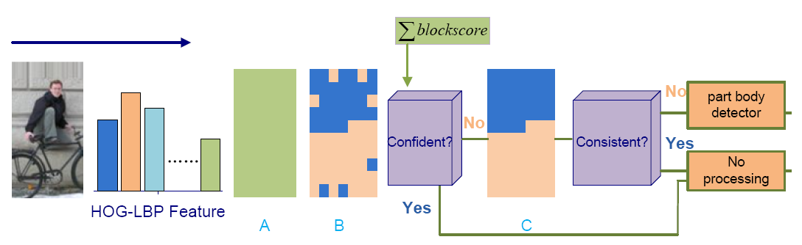
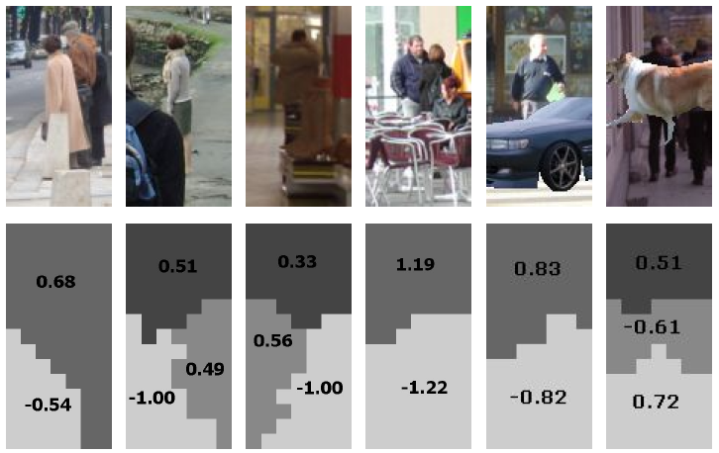
Segmenting the local classifiers for occlusion inference
The over all occlusion reasoning/handling framework.

Slide 14
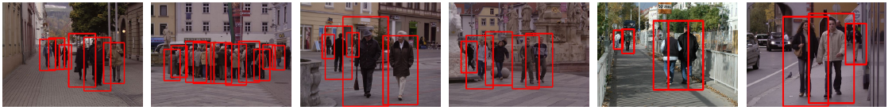
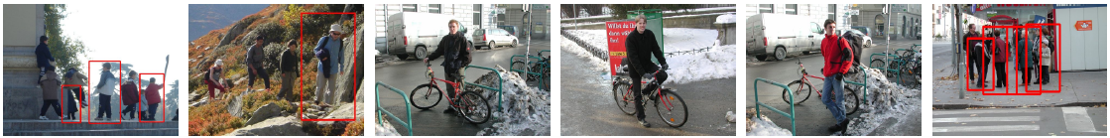
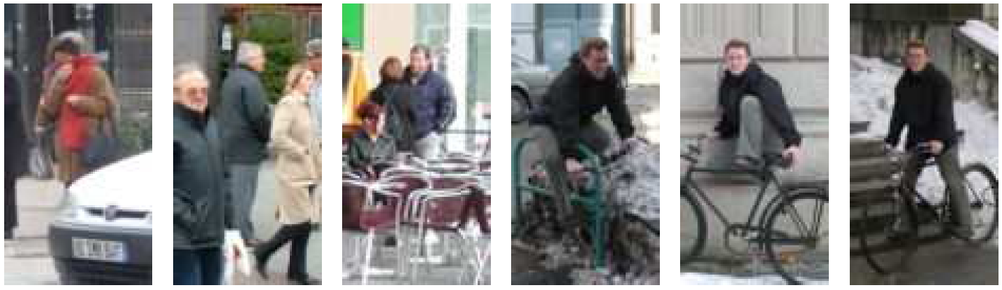
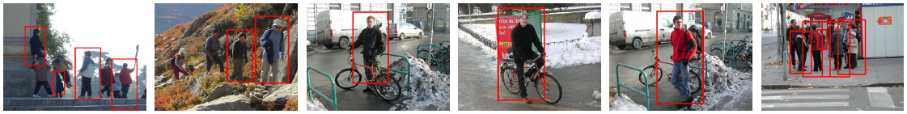
The detection performance with occlusion handling
The detection rate improvement is less than 1% for INRIA Dataset.
There are very few occluded pedestrians in INRIA dataset.
28 images with occlusion are missed by HOG-LBP detector when FPPW=10⁻⁶
The occlusion handling pickup 10 of them.
Samples of corrected miss detection

Slide 15
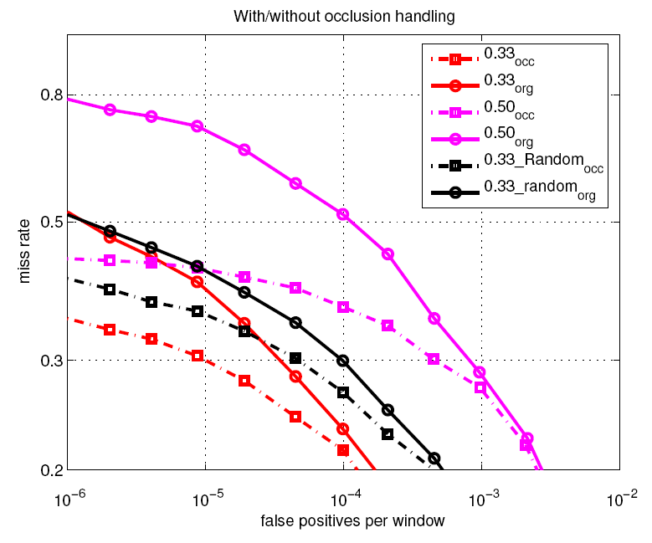
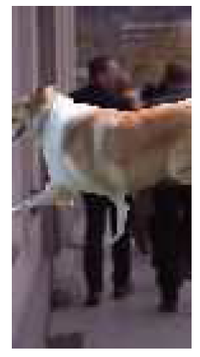
Adding occlusions to INRIA dataset

Slide 16
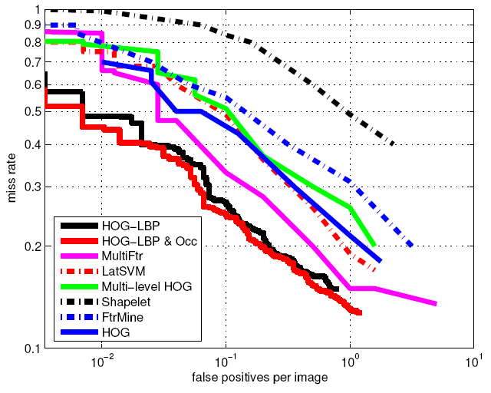
Evaluation using False Positive Per scanning Imange (FPPI)
[1] P. Sabzmeydani and G. Mori. Detecting pedestrians by learning shapelet features.
In CVPR 2007.
[2] P. Dollar, Z. Tu, H. Tao, and S. Belongie. Feature mining for image classification. In CVPR 2007
[3] S. Maji, A. Berg, and J. Malik, “Classification using intersection kernel support vector machines is efficient,” in CVPR 2008.
[4] N. Dalal and B. Triggs, “Histograms of oriented gradients for human detection,” in CVPR, 2005.
[5] P. Felzenszwalb, D. McAllester, and D. Ramanan. A discriminatively trained,
multiscale, deformable part model. In CVPR, 2008.
[6] C.Wojek and B. Schiele. A performance evaluation of single and multi-feature people detection. DAGM 2008.
[7], [8] HOG-LBP w/o occlusion handling

Slide 17
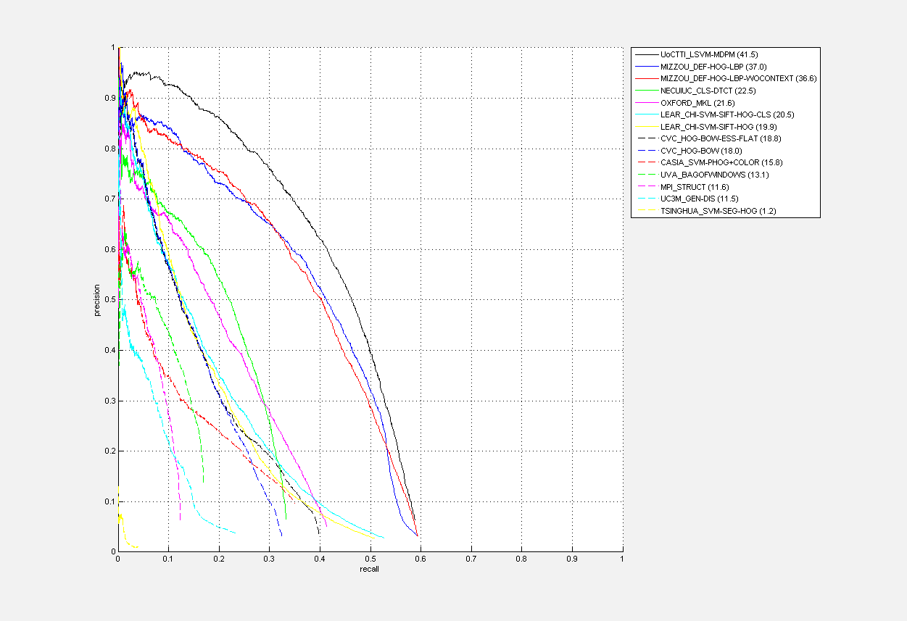
Pascal 2009 Grand Challenge
precision
Average Precision:
UoCTTI: 41.5
U of Missouri: 37.0
Oxford_MKL: 21.6
recall

Slide 18
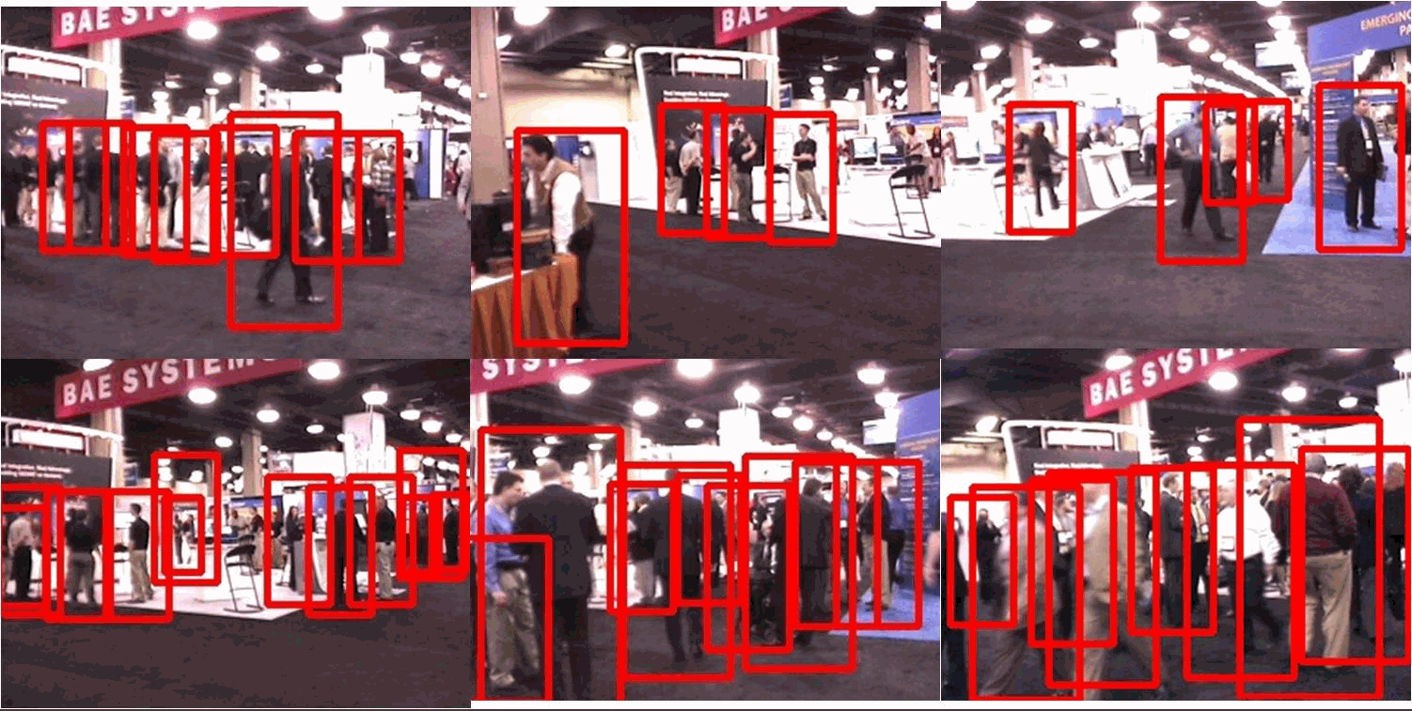
Sample results in Geoint 2009

Slide 19
Evaluation Issue
Many factors affect FFPI: Like nonmaximum suppression, bandwidth of meanshift, local thresholding/filtering before merging.
Therefore:
  Using FPPW for sliding window classifier to select feature and classification scheme.
  WARNING: avoid encoding the class label implicitly
  Using FPPI to evaluate the over all performance of the detector, can be used as a protocol to compare all kinds of detectors

Slide 20
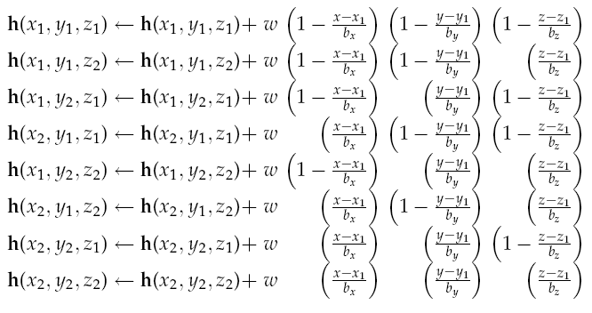
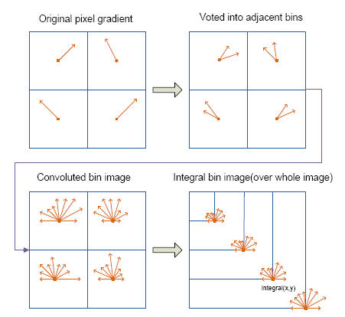
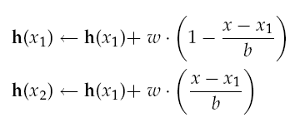

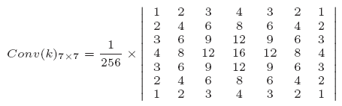
Speed Issue: do trilinear Interpolation as convolution
Linear interpolation
Trilinear interpolation
Trilinear interpolation can now be integrated into integral histogram, and improve the detection by 3%-4%, at FPPW=10⁻⁴.
Adjacent histograms cover independent data after convolution. SPMD, this is very important if you want to use GPU!
Memory bandwidth is more precious than GPU cycles.

Slide 21
Conclusion and Demo
The HOG-LBP feature achieves the state of the art detection.
Segmentation on local classifications inside sliding window helps to infer occlusion.
Implementing trilinear interpolation as a 2D convolution makes it an addable component of integral histogram.
Demo
  Does it work? Press keyboard and pray......
  We may still have long way to go

